Slide 1
Challenges for 21st Century Grids
Rupendra Bhatnagar
General Secretary and Convener
5th October 2016

Slide 2
Electric Grid is on the threshold of a paradigm shift!
With more and more distributed generation resources being connected at the low voltage end of the grid, traditional boundaries between generation, transmission and distribution is fast disappearing - evolving into one “Integrated Grid”
With consumers becoming “prosumers”, the grid that is designed and built for one-way flow of electricity is now experiencing bi-directional flow of electrons
Debate on whether to invest in transmission or in storage – the choice between “Generation + Transmission + Distribution” AND “Distributed Generation + Storage + Distribution” is real
Power purchase is moving from Volumetric Tariffs to Transactive Tariffs as Inflexible Demand has become Price Responsive Demand: Era of Smart Energy OR Transactive Energy
Loads have changed – Incandescent lamps and motors that could accommodate frequency and voltage excursions comprised majority of the load on the grid in the past. In the digital word new loads require quality power at constant frequency and voltage
The “Merit Order Dispatch” has graduated towards an “ Energy Efficient and Environmentally Responsible Dispatch” regime
Solar PV has already achieved grid parity in many parts of the globe which is about to unleash a rooftop PV revolution
Large fleets of Electric Vehicles that can be aggregated as virtual power plants which could support short term supply-demand balancing will make the grid even more dynamic and complex
After a century of focus on centralized power generation and creation of massive electric grids, today the focus is towards de-centralized generation

Slide 3
Evolving Smart Grid will be a “Grid of Things”
“The grid will soon emerge as the “grid of things” like how the internet is evolving as “internet of everything””
--- Chris Jones, President, Pacific Gas & Electricity, USA
Traditional grid
ability to monitor and control power flows in real-time is limited to the HV network
In the LV network, the power system operator has no visibility on who is consuming how much electricity when and where
Smart grid
with smart sensors and smart meters connected to computers in the control room, it is possible to remotely monitor and control the flow of electricity in real time to every customer or even to every smart appliances inside a customer’s premise
In offices and homes increasing share of consumption is by devices using direct current – laptops, LED/CFL bulbs, TVs and LCD/LED screens, phones etc; and increasing share of generation also is from distributed DC sources – solar PV. Soon there will be justifications for parallel DC distribution systems or DC grids in offices and houses
The evolving smart grid of the 21st century will be drastically different than the present grid

Slide 4
Distributed Assets Integration in the Grid
Integrate assets for storage, DR, DERs, VPPs, etc.
Intermittency of power to be balanced by quick acting generation
Future balancing sources like MW scale etc
Forecasting capabilities
Strategically placed energy storage devices can also help in relieving intermittency
Scheduling Coordination
Virtual Power Plant
Aggregation, Optimization, Load/Solar/Wind Forecasting
Appliance O&M
O&M, Reporting, Billing, Ticketing
M2M Control
M&V, Dispatch, Predictive Control
Energy Analytics
Site Control
Energy (TOU), Solar + Storage, Self Consumption, Load Control
Distributed Energy Resources
Microgrids, C&I Loads, Pool Pumps, Batteries, Solar, Lighting, HVAC, EV Charging, CHP

Slide 5
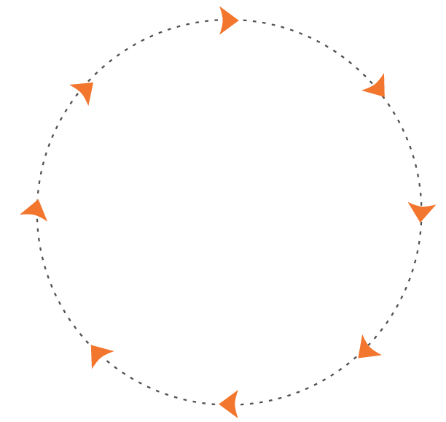
New Capabilities which Needs to be Developed
All Services
All Assets
DERMS
DER
Analyze
Manage
Solar
Storage Mgmt
Storage
Demand Charge Mgmt
Control
Enroll
CHP
Bring-Your-Own-Thing
DR
Notify
Forecast
Water Heaters, HVAC
C&I Direct Load Control
Thermostats
Behavioral DR
Schedule
Optimize
EV/EVSE
Virtual Power Plant
Lighting
All Customer Classes
Residential
Commercial
Industrial

Slide 6
Brief on ISGF
India Smart Grid Forum (ISGF), registered under Indian Societies Registration Act (Act XXI of 1860) is a Public Private Partnership (PPP) initiative of Ministry of Power, Government of India for accelerated development of smart grid technologies in the Indian power sector
Operational since November 2011
200+ Members: Ministries (MoP and MNRE), Government Institutions (CEA, CPRI, BEE, CERC), PSUs, Utilities, Regulatory Commissions, Academia, Research, Students etc
Ten Working Groups - WG 1: Advanced Transmission & Distribution; WG 2: Smart Cities; WG 3&4: Metering & Communications; WG 5: Consumption & Load Control; WG 6: Policy & Regulations; WG 7: Architecture & Design; WG 8: Pilots & Business Models; WG 9: Renewables & Microgrids; WG 10: Cyber Security
Activities:
Assist MoP and other stake holders in Smart Policies and Programs; we work with MoHI, MNRE, MoUD, BIS and DoT
Training Programs and Workshops
White Papers and Technical Reports
Smart Grid Bulletin
India Smart Grid Knowledge Portal - launched in Jan 2013 (www.indiasmartgrid.org) – most popular smart grid portal in the world today
India Smart Grid Week (www.isgw.in)
Advisory Services - presently making Smart Grid Roadmap for BESCOM

Slide 7
Publications by ISGF
Smart Grid Bulletin - Circulation: 2,500 printed copies to key decision makers in Indian power sector; > 55,000 electronic copies to power sector professionals around the world
Regular webinars on technical topics
White Papers on important topics
Latest Publications of ISGF:
AMI Cost Benefit Analysis and Rollout Framework for India (July 2016)
Future of Transportation
Electrification of transportation for sustainable solution for emission reduction in cities
Smart Grid Knowledge Paper (co-authored by Accenture and ISGF) in March 2016
Smart Grid Projects – a global snapshot (2015)
Compendium of Training Programs for Power Sector Personnel
Feasibility study for converting AIS substations to GIS substations by commercializing the land that would be saved
Frequency Band Allocation for PLC Communications
Leveraging R-APDRP Assets to build Smarter Cities at marginal cost
Who is Who guide in Indian Smart Grid and Smart Cities domain
M2M Communications for the Power Sector
Policy Framework for Electric Rickshaws in Delhi

Slide 8
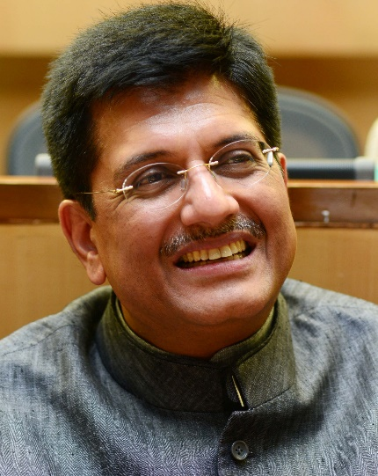
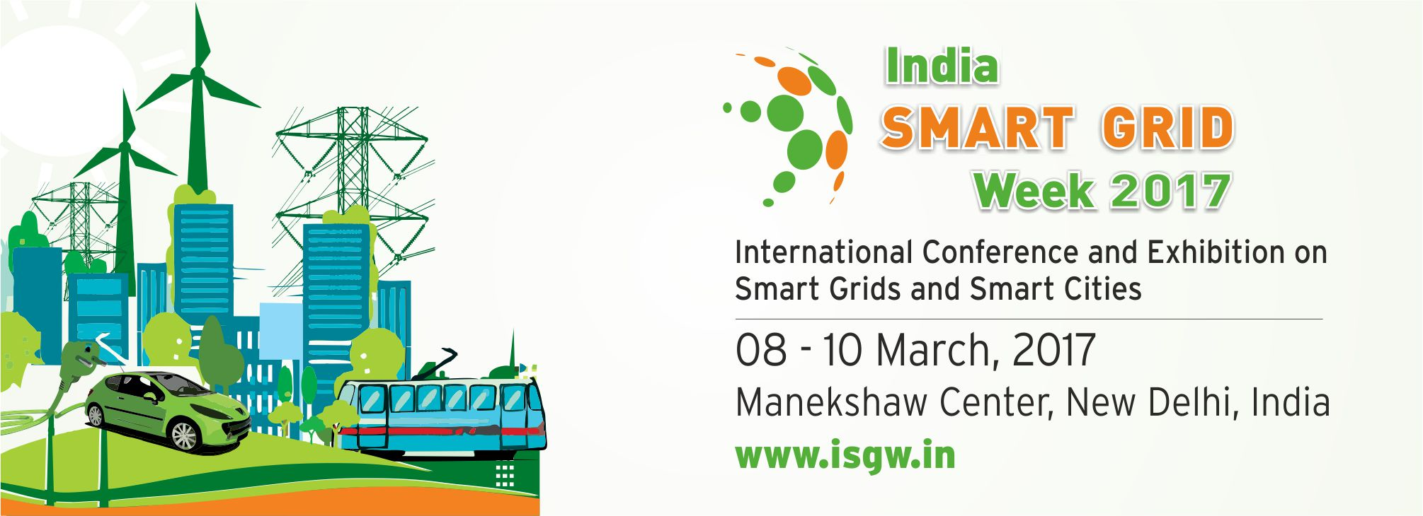
India Smart Grid Week
India Smart Grid Week (ISGW) was first held in March 2015 at Bangalore - worlds top most Experts presented (94 speakers from 16 countries) on various topics
ISGW 2016 was held from 16 - 18 March 2016 at Manekshaw Centre, New Delhi, India
Key Statistics - ISGW 2015
1500+ Participants | 33 Countries
50+ Utilities | 200+ International Delegates
203 Speakers | 60+ Sponsors & Exhibitors
400+ Organisations | 30 Supporting Partners
50+ Media Partners | 48 Technical Papers Published

Slide 9
Thank you for your kind attention
For discussions/suggestions/queries email:
rupendra@indiasmartgrid.org
www.isgw.in

